Slide 1
Software Agile Project Management Composition
This slide contains material that is copied from the book Agile Project Manager_v2_handbook by Agile Business Consortium. All rights reserved. No part of this material may be reproduced or transmitted in any form or by any means without the prior written permission of the copyright owner. This material is used here for educational purposes under the doctrine of fair use, with the intention to support learning and teaching.
For more information, please refer to the original source:
Book Title: Agile Project Manager_v2_handbook Author: Agile Business Consortium
Publisher: Buckland Media Group Limited
Year of Publication: 2017
Please consult the book for further details and complete content.

Slide 2
Outline
Introduction to Dynamic Systems Development Method (DSDM)
The composition of DSDM
DSDM and Scrum
Comparison among Scrum, Kanban, and Scrumban
Introduction to Project Management Tools

Slide 3
Introduction : Dynamic Systems Development Method (DSDM)
Recap…
The DSDM philosophy is that:
“best business value emerges when projects are aligned to clear business goals, deliver frequently and involve the collaboration of motivated and empowered people.”
This is achieved when
Clear Roles & Responsibilities: DSDM assigns well-defined roles covering business, technical, management, and process interests to ensure balanced representation across the project.
Collaboration & Communication: All team members work closely together, breaking down barriers and fostering effective communication to drive project success.
Empowered, Self-Organising Teams: The best solutions come from teams that are empowered to self-organise and take responsibility within agreed boundaries.

Slide 4
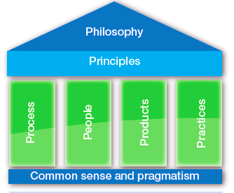
The Composition of DSDM
“best business value emerges when projects are aligned to clear business goals, deliver frequently and involve the collaboration of motivated and empowered people.”
A set of 8 principles that bring the philosophy into practice.
The lifecycle, phases, timeboxing, iteration, governance flow. Describes how work is structured.
The deliverables, artefacts, outputs (business, solution, governance) required. Defines what is produced and tracked.
Roles, responsibilities, team interactions, empowered decision-making. Captures who does what, and how people collaborate.
Recommended techniques, methods, workshops, modelling, testing, etc. These are tools & approaches to support execution.
Common sense: using sound practical judgment, independent of over-theory.
Pragmatism: making decisions based on immediate practical consequences rather than rigid theory or dogma.

Slide 5
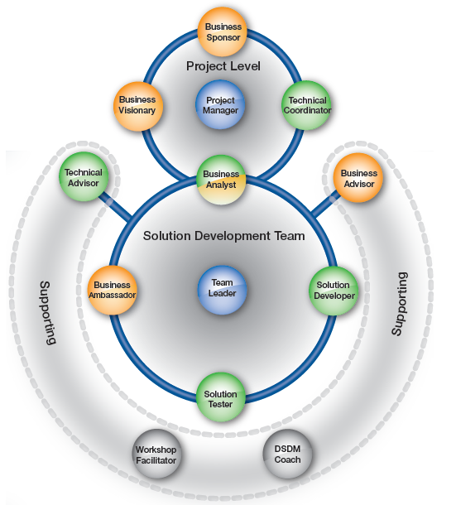
The People in DSDM
Colour Scheme (Roles of Interest): Orange = Business view, Green = Solution/technical view, Blue = Management/leadership view, Grey = Process view, Mixed = Covers multiple views.
Role Categories:
    Project-level roles: Business Sponsor, Business Visionary, Technical Coordinator, Project Manager, Business Analyst → direct, manage, and govern the project.
    Solution Development Team roles: Business Ambassador, Solution Developer, Solution Tester, Business Analyst, Team Leader → engine room of the project, shaping and building the solution.
    Supporting roles: Business Advisors, Technical Advisors, Workshop Facilitator, DSDM Coach → provide guidance, expertise, and support as needed.
Role Flexibility: One person can hold multiple roles, or a role may be shared by several people, provided communication and collaboration remain effective.

Slide 6
DSDM and Scrum
Aspect | DSDM | Scrum
Scope / Lifecycle Coverage | Covers the entire project lifecycle: pre-project, feasibility, foundations, evolutionary development, deployment, post-project. | Primarily focused on the development lifecycle (product backlog → sprints → increments). Governance / project initiation phases are less prescribed.
Governance & Structure | More structured governance, roles, disciplines, and artefacts. Designed to balance agility with control. | Lightweight framework with minimal prescribed governance outside the core roles and events.
Fixed vs Variable Elements | Fixes time, cost, quality early on; scope is variable and managed via MoSCoW prioritisation. | Fixes scope (commitment) per sprint; time is fixed in each sprint, cost is implicit (team capacity).
Requirements / Scope Management | Uses MoSCoW prioritisation to categorise requirements (Must, Should, Could, Won’t). | Uses product backlog ordering / prioritisation; changes may be made between sprints but generally backlog is fluid.
Roles & Role Variety | Many roles: Business Sponsor, Business Visionary, Technical Coordinator, Business Analyst, Solution Developer, etc. Rich role structure. | Fewer roles: Product Owner, Scrum Master, Development Team. More lean and focused.
Change Handling | Accepts change, but within boundaries; scope is trimmed if needed (using MoSCoW) to meet time and cost constraints. | Encourages change, backlog is adaptive; within a sprint, changes are limited to preserve focus.
Best Use / Fit | Larger projects needing agility plus governance — especially where project initiation, accountability, stakeholder roles, and full lifecycle governance are needed. | Product development teams wanting agility, fast feedback, minimal overhead, and frequent delivery in iterative cycles.
Complexity & Overhead | Higher overhead because of more roles, more governance, more artefacts and control points. | Lower overhead; lean structure with less prescribed artefacts and roles.

Slide 7
Comparison among Scrum, Kanban, and Scrumban
Aspect | Scrum | Kanban | Scrumban
Description | Lightweight framework to develop and sustain complex products via defined accountabilities, events, and artifacts. | Visual flow method that optimizes work by visualizing tasks and limiting WIP to keep work moving. | Hybrid that combines Scrum’s cadence/ceremonies with Kanban’s visual flow and WIP limits for more flexibility.
Iterations/Timeboxing | Work happens in fixed-length Sprints of one month or less. (Many teams use 1–4 weeks.) | No fixed iterations; teams pull work continuously. | Uses short sprints when helpful plus continuous pull as capacity allows.
Roles & Events | Explicit events: Sprint Planning, Daily Scrum, Sprint Review, Sprint Retrospective (within each Sprint). | Few mandated roles/ceremonies; teams keep it lightweight and adapt meetings to need. | May keep some Scrum ceremonies (e.g., standups/retros) while applying Kanban flow controls.
Work in Progress (WIP) | WIP is indirectly constrained by the Sprint commitment and Sprint Goal. | Explicit WIP limits per workflow stage to expose bottlenecks and stabilize flow. | Uses Kanban-style WIP limits with simple policies/triggers to manage flow.
Planning & Adaptation | Plan at the start of each Sprint; avoid changes that endanger the Sprint Goal during the Sprint. | Continuous prioritization; new work is pulled as capacity appears. | On-demand planning triggered when the ready backlog drops below a threshold.
Best Use Case | Cross-functional product teams needing structure and a steady delivery cadence. | Ops/support/maintenance or any flow-based work needing adaptability and smooth throughput. | Teams that want a balance of structure and flexibility, or are evolving from Scrum↔Kanban.

Slide 8
Introduction to Project Management Tools
Category | Focus / Purpose | Key Features
All-in-One / Integrated Tools | Provide end-to-end project management coverage | Task planning , scheduling, resource allocation, dashboards, reporting, collaborating.
Task / To-Do Management Tools | Managing individual tasks and simple workflows | Task lists, assignment, due dates, status tracking
Time / Schedule Tools | Focus on timelines and time tracking | Gantt charts, calendars, despendencies, milestones
Resource Management Tools | Allocating and balancing resources | Workload view, availability, conflicts, forecasts
Collaboration / Communication Tools | Enabling team communication and document sharing | Messaging, file sharing, comment threads, versioning
Speacilized / Industry – Specific Tools | Tailored team specific domains or methodologies | For software: backlog + issue tracking for construction: equipment and materials planning: for marketing : campaign timelines
On-Premise vc Cloud / Deployment Types | Based on how the tool is hosted and accessed | Installed servers (on-premise) vs Saas / cloud tools; mobile or desktop clients
Project Management Tools
Project management tools are software or systems that support planning, executing, controlling, and closing of projects.
It help teams organize tasks, monitor progress, allocate resources, communicate, and report status.
These tools act as enablers — they don’t replace good process or governance, but make applying them easier, more visible and efficient.
The choice of tool depends on factors like project complexity, team size, methodology (Agile, Waterfall, hybrid), and integration needs.
Here are common categories, with their focus and key features:

Slide 9
Comparison of the Project Management Tools
Tool | Strengths / Key Features | Weaknesses / Trade-offs | Best Fit / Use Case
Jira | Strong support for Agile (Scrum, Kanban ,hybrid) with boards, backlogs, roadmaps, and integrations. Powerful automation templates and workflow customization. Excellent issue / fast tracking, reporting, and visibility across teams. | Can be complex to configure and maintain for non-technical teams. Some features (reporting, advanced planning) may require add-ons or plugins. | Software development teams. Agile teams needing robust issue tracking and process control.
Trello | Simplicity and ease of use ; intuitive Kanban board interface ideal for small teams. Lightweight fast setup, minimal training required | Limited built-in advanced features (reporting, resource management)- relies heavily on integrations of ‘Power-Ups’. Less suitable for large or complex projects without customization or add-ons. | Small to medium teams. Simple or visual projects, task tracking.
Clickup | Rich feature set : docs, goals, time tracking , customize workflows, dashboards. Highly customizable with many view options (list board, Gantt, etc.). | Steeper learning curve and complexity in setup. Overhead to maintain configurations and avoid feature overload. | Teams that want an” all-in –one” platform replacing many tools, scaling beyond simple task tracking.
Notes:
Business-focused products (Orange):
Business Case: Defines justification and ongoing validity of the project.
Prioritised Requirements List: Maintains evolving business needs, ordered by priority.
Supporting Materials: Documents and inputs supporting requirements and design.
Benefits Assessment: Evaluates whether expected business benefits have been achieved.
Solution-focused products (Green):
Solution Architecture Definition: Outlines high-level structure and design of the solution.
Development Approach Definition: Defines how the solution will be built and evolved.
Evolving Solution: The core deliverable, refined through iterations.
Prototypes / Models / Testing & Assurance: Artefacts supporting solution exploration and validation.
Solution Increment / Deployed Solution: Completed parts delivered into use.
Management/control products (Blue):
Delivery Plan: High-level schedule for delivering the solution.
Management Approach Definition: Describes governance, monitoring, and reporting.
Timebox Plan & Review Records: Short-cycle plans and progress records.
Feasibility Assessment / Foundations Summary: Early justification and baseline understanding.
Project Review Report: Captures performance and lessons learned.
Governance Products (marked "G"):
Used for approval gateways, compliance, and demonstrating alignment with corporate/regulatory standards.

Slide 10
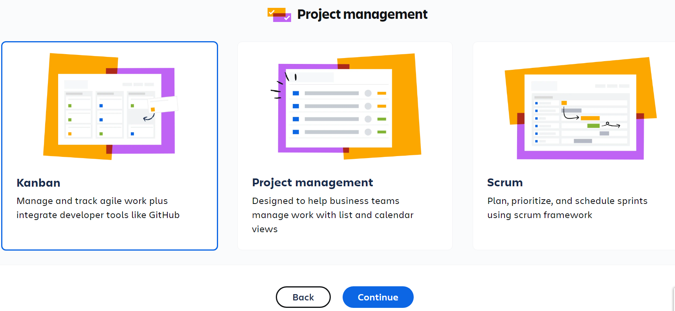
Jira Tool

Slide 11
Summary
Philosophy: The guiding belief — “best business value emerges when projects align with clear business goals, deliver frequently, and involve empowered people.”
Principles: Eight principles serve as the bridge between philosophy and practice, enforcing the mindset and behaviors required to make DSDM effective.
Four Supporting Domains: The philosophy + principles are supported by:
    Process: Lifecycle, phases, timeboxing, governance flows — how work is structured
    People: Roles, responsibilities, collaboration, decision making — who does what
    Products: Deliverables, artefacts, outputs across business, solution, governance — what is produced
    Practices: Techniques, workshops, modelling, testing, other methods — how work is done

Slide 12
Assessment – WBL Project
Assessment | Example of Case study | Instruction | Rubric
Assignment 1 – User Stories | The university wants to build an e-learning platform for online courses, quizzes, and course materials. Requires functional & non-functional Specification | Write a set of 8–12 user stories (As a <role> I want <feature> so that <benefit>) for key functions (course enrolment, content upload, assessment). | Clarity & Format (user stories well formed) Coverage (important system aspects captured) Logical Cohesiveness (stories fit together)
Assignment 2 – MoSCow Classification | From the same e-learning case, refine the user stories and classify them properly. | Prioritise US using MoSCoW (Must, Should, Could, Won’t). Justify each classification with business value / technical risk. Propose a Minimum Usable Subset (MUS). | Correct Prioritisation (justified MoSCoW classification) Balance in MUS (reasonable Must vs Should / Could) Alignment with Case Business Goals Consistency & Logic
Assignment 3 – Time-Boxing | Use the previously prioritised stories for time-boxing. | Partition user stories into 2–3 timeboxes (iterations) of fixed duration (e.g. 2 weeks each). Assign stories to timeboxes, ensure balance. Provide a simple schedule / plan showing which features delivered when. | Feasibility (workload per timebox realistic) Cohesion (dependencies respected) Value Delivered Early (Musts in first boxes) Clarity of Plan / Schedule
Assignment 4 – Monetization Planning | For the e-learning system, design how the platform can generate revenue or financial sustainability. | Propose 2–3 monetization strategies (e.g. subscription, freemium, course fees, ads). Model expected income, costs, breaking-even point. Discuss risks and how Agile delivery interacts with monetization (e.g. feature gating, MVP). | Business Viability (realistic financial model) Creativity / Innovation of revenue ideas Risk & Mitigation Integration with Agile / delivery plan

Slide 13
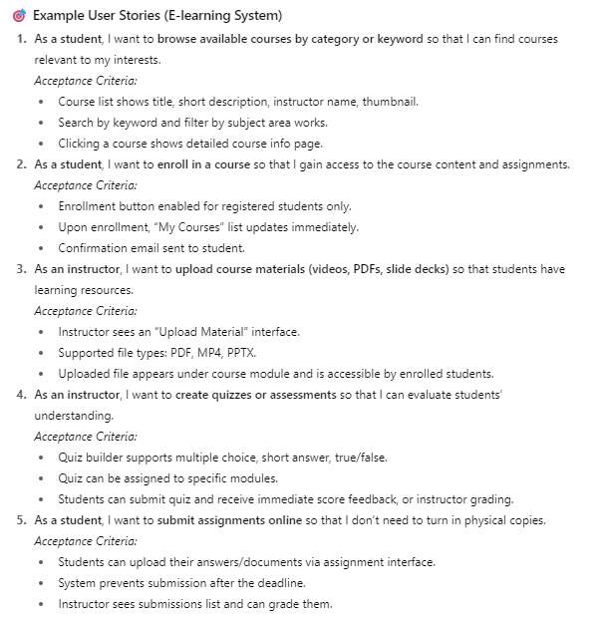
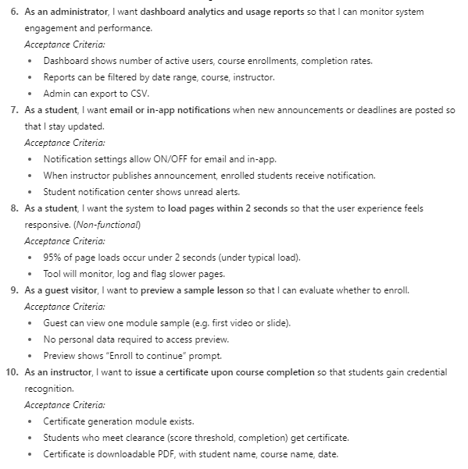
Assignment 1 – User Stories

Slide 14
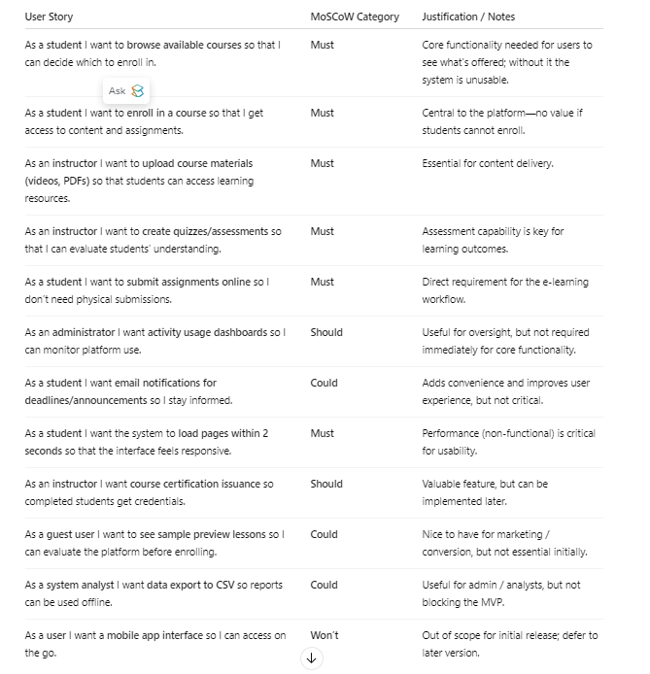
Assignment 2 - MoSCow Classification

Slide 15
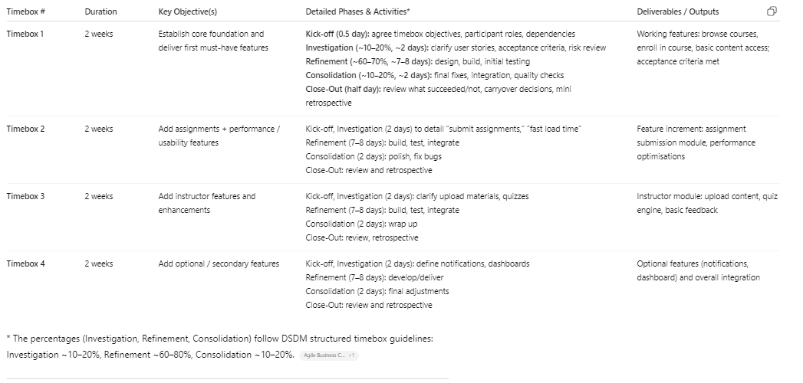
Assignment 3 – Timebox Plan

Slide 16
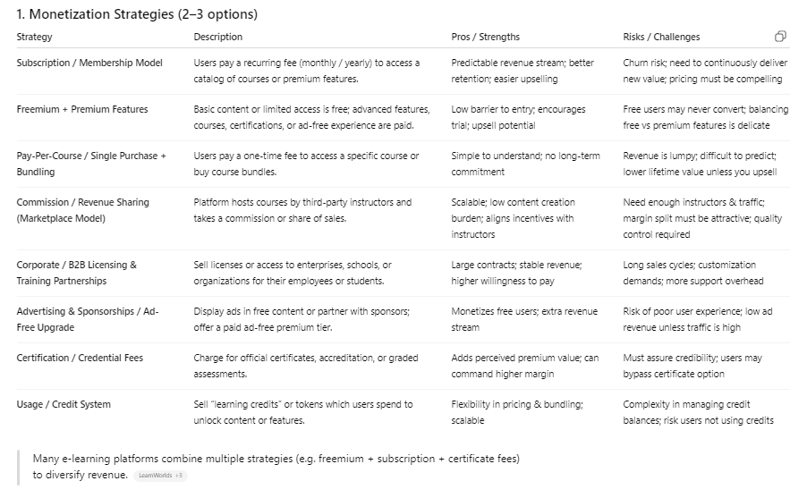
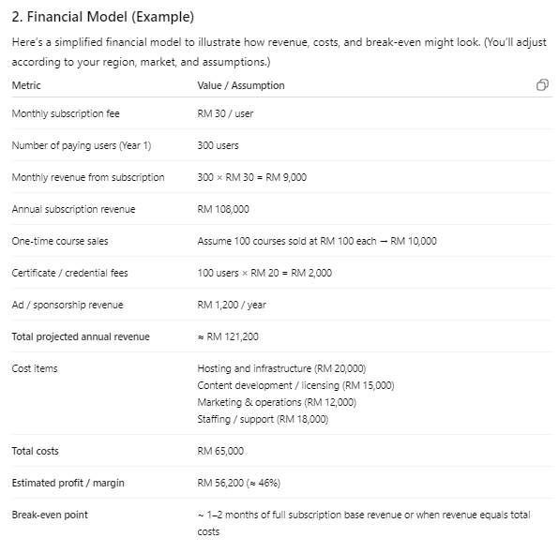
Assignment 4 – Monetization Plan

Slide 17
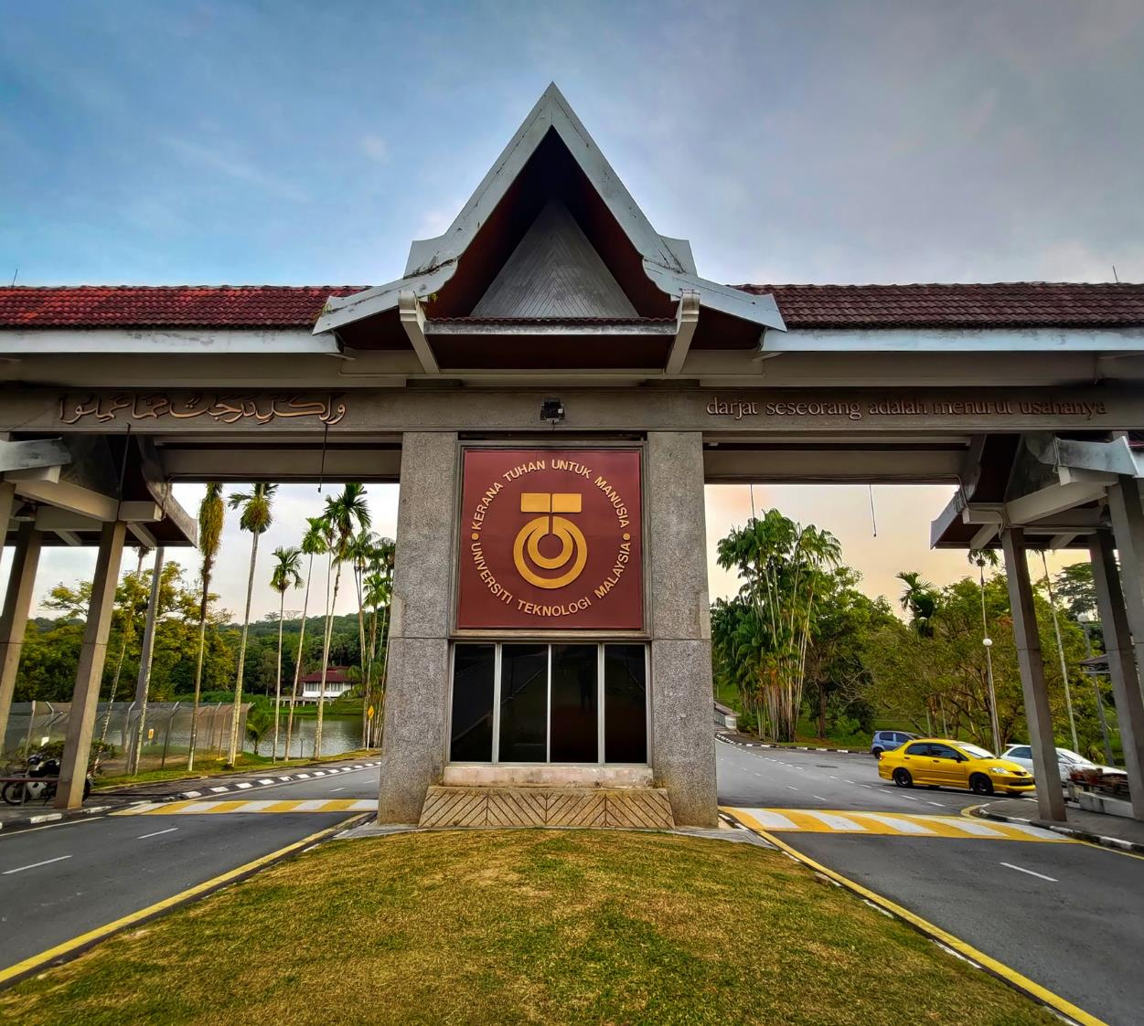






THANK YOU
In the Name of God for Mankind
www.utm.my

